Slide 1
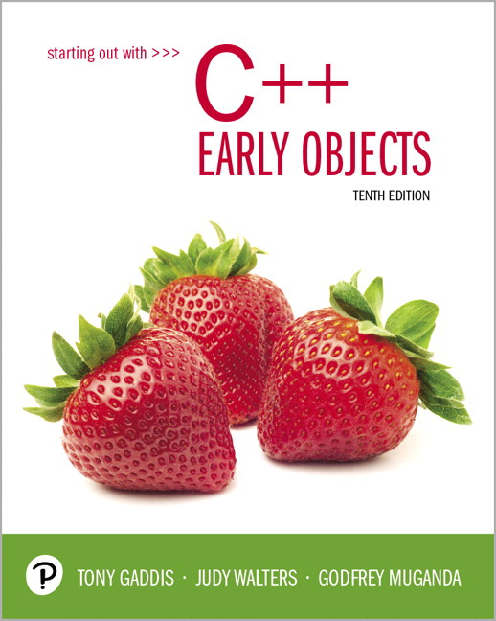
Starting Out with C++ Early Objects
Tenth Edition
Chapter 16
Exceptions and Templates

Slide 2
Topics
16.1 Exceptions
16.2 Function Templates
16.3 Class Templates
16.4 Class Templates and Inheritance

Slide 3
16.1 Exceptions
An exception is a value or an object that indicates that an error has occurred
When an exception occurs, the program must either terminate or jump to special code for handling the exception.
The special code for handling the exception is called an exception handler

Slide 4
Exceptions – Key Words
throw – followed by an argument, is used to signal an exception
try – followed by a block { }, is used to invoke code that may throw an exception
catch – followed by a block { }, is used to process exceptions thrown in a preceding try block. It takes a parameter that matches the type of exception thrown

Slide 5
Throwing an Exception
Code that detects the exception must pass information to the exception handler. This is done using a throw statement:
throw string("Emergency!");
throw 12;
In C++, information thrown by the throw statement may be a value of any type

Slide 6
Catching an Exception 1 of 2
Block of code that handles the exception is said to catch the exception and is called an exception handler
An exception handler is written to catch exceptions of a given type: For example, the code
catch(string str)
{
cout << str;
}
can only catch exceptions that are string objects

Slide 7
Catching an Exception 2 of 2
Another example of a handler:
catch(int x)
{
cerr << "Error: " << x;
}
This can catch exceptions of type int

Slide 8
Connecting to the Handler
Every catch block is attached to a try block of code and is responsible for handling exceptions thrown from that block
try
{
// code that may throw an exception
// goes here
}
catch(char e1)
{
// This code handles exceptions
// of type char that are thrown
// in the try block
}

Slide 9
Execution of Catch Blocks
The catch block syntax is similar to a that of a function
A catch block has a formal parameter that is initialized to the value of the thrown exception before the block is executed

Slide 10
Exception Example
An example of exception handling is code that computes the square root of a number.
It throws an exception in the form of a string object if the user enters a negative number

Slide 11
Example
int main( )
{
try
{
double x;
cout << "Enter a number: ";
cin >> x;
if (x < 0) throw string("Bad argument!");
cout << "Square root of " << x << " is " << sqrt(x);
}
catch(string str)
{
cout << str;
}
return 0;
}
Notes:
See pr16-01.cpp

Slide 12
Flow of Control
The computer encounters a throw statement in a try block
The computer evaluates the throw expression, and immediately exits the try block
The computer selects an attached catch block that matches the type of the thrown value, places the thrown value in the catch block’s formal parameter, and executes the catch block

Slide 13
Uncaught Exception
An exception may be uncaught if
there is no catch block with a data type that matches the exception that was thrown, or
it was not thrown from within a try block
The program will terminate in either case

Slide 14
Throwing an Exception Class
An exception class can be defined and thrown
A catch block must be designed to catch an object of the exception class
The exception class object can pass data to the exception handler via data members
Notes:
See pr16-02.cpp and IntRange.h, pr16-03.cpp and IntRange2.h, and finally pr16-04.cpp and IntRange3.h

Slide 15
Handling Multiple Exceptions
Multiple catch blocks can be attached to the same try block of code. The catch blocks should handle exceptions of different types
try{...}
catch(int iEx){ }
catch(string strEx){ }
catch(double dEx){ }

Slide 16
Exception When Calling new
If new cannot allocate memory, it throws an exception of type bad_alloc
Must #include <new> to use bad_alloc
You can invoke new from within a try block, then use a catch block to detect that memory was not allocated.
Notes:
See pr16-05.cpp

Slide 17
Where to Find an Exception Handler?
The compiler looks for a suitable handler attached to an enclosing try block in the same function
If there is no matching handler in the function, it terminates execution of the function, and continues the search for a handler starting at the point of the call in the calling function.

Slide 18
Unwinding the Stack
An unhandled exception propagates backwards into the calling function and appears to be thrown at the point of the call
The computer will keep terminating function calls and tracing backwards along the call chain until it finds an enclosing try block with a matching handler, or until the exception propagates out of main (terminating the program).
This process is called unwinding the call stack

Slide 19
Nested Exception Handling
try blocks can be nested in other try blocks
try
{
processData(); // function
// containing a try block
}
catch(string s)
{ }

Slide 20
Rethrowing an Exception
Sometimes an exception handler may need to do some tasks, then pass the exception to a handler in the calling environment.
The statement
throw;
with no parameters can be used within a catch block to pass the exception to a handler in the outer block

Slide 21
16.2 Function Templates
Function template: A pattern for creating definitions of functions that differ only in the type of data they manipulate. It is a generic function
They can be better than overloaded functions, since the code defining the algorithm of the function is only written once
Notes:
See pr16-06.cpp

Slide 22
Function Template Example
Two functions that differ only in the type of the data they manipulate
void swap(int &x, int &y)
{ int temp = x; x = y;
y = temp;
}
void swap(char &x, char &y)
{ char temp = x; x = y;
y = temp;
}

Slide 23
A swap Template
The logic of both functions can be captured with one template function definition
template<class T>
void swap(T &x, T &y)
{ T temp = x; x = y;
y = temp;
}
Notes:
See pr16-07.cpp

Slide 24
Using a Template Function
When a function defined by a template is called, the compiler creates the actual definition from the template by inferring the type of the type parameters from the arguments in the call:
int i = 1, j = 2;
swap(i,j);
This code makes the compiler instantiate the template with type int in place of the type parameter T

Slide 25
Function Template Notes 1 of 2
A function template is a pattern
No actual code is generated until the function named in the template is called
A function template uses no memory
When passing a class object to a function template, ensure that all operators referred to in the template are defined or overloaded in the class definition
Notes:
See pr16-08.cpp

Slide 26
Function Template Notes 2 of 2
All data types specified in template prefix must be used in template definition
Function calls must pass parameters for all data types specified in the template prefix
Function templates can be overloaded – need different parameter lists
Like regular functions, function templates must be defined before being called
Notes:
See pr16-09.cpp and pr16-10.cpp

Slide 27
Where to Start When Defining Templates
Templates are often appropriate for multiple functions that perform the same task with different parameter data types
Develop the function using usual data types first, then convert to a template:
add the template prefix
convert data type names in the function to type parameters (i.e., T types) in the template

Slide 28
Function templates and C++ 11
As of C++ 11, the key word typename may be used instead of class in the template prefix.
Thus,
template<class T>
May be written as
template<typename T>

Slide 29
16.3 Class Templates
It is possible to define templates for classes. Such classes define abstract data types
Unlike functions, a class template is instantiated by supplying the type name (int, float, string, etc.) at object definition

Slide 30
Class Template
Consider the following classes
Class used to join two integers by adding them:
class Joiner
{ public:
int combine(int x, int y)
{return x + y;}
};
Class used to join two strings by concatenating them:
class Joiner
{ public:
string combine(string x, string y)
{return x + y;}
};

Slide 31
Example class Template
A single class template can capture the logic of both classes: it is written with a template prefix that specifies the data type parameters:
template <class T>
class Joiner
{
public:
T combine(T x, T y)
{return x + y;}
};

Slide 32
Using Class Templates
To create an object of a class defined by a template, specify the actual parameters for the formal data types
Joiner<double> jd;
Joiner<string> sd;
cout << jd.combine(3.0, 5.0);
cout << sd.combine("Hi ", "Ho");
Prints 8.0 and Hi Ho
Notes:
See SimpleVector.h, pr16-11.cpp

Slide 33
Member Function Definitions Outside of a Template Class
If a member function is defined outside of the class, then the definition requires the template header to be prefixed to it, and the template name and type parameter list to be used to refer to the name of the class:
template<class T>
T Joiner<T>::combine(T x, T y)
{return x + y;}

Slide 34
16.4 Class Templates and Inheritance
Templates can be combined with inheritance
You can derive a template class from a template class
Other combinations are possible:
Derive a template from an ordinary class
Derive an ordinary class from a template
Notes:
See pr16-12.cpp and SearchVect.h

Slide 35
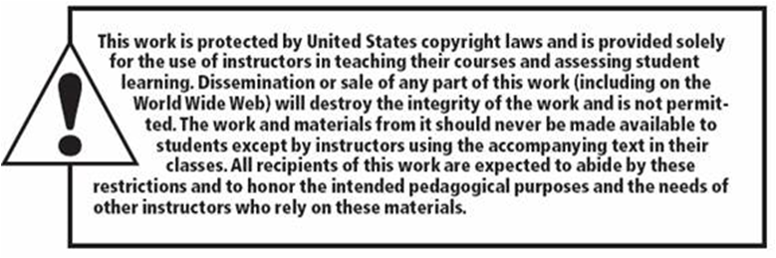
Copyright

